Slide 1



Onboard Carbon Capture and Storage Assessment
Webinar Presentation
7 May 2026

Slide 2


Agenda
Description of oCCS Technologies
Presentation of the Disposal Pathways
Review of the Regulatory framework
Conclusion & Key Findings

Slide 3

Why Onboard Carbon Capture?
A transitional option under increasing regulatory and carbon constraints
DECARBONISATION GAP
Shipping is a hard to abate sector and vessels will continue to emit well into 2030s
FUEL UNCERTAINTY
Alternative fuels face limitations in availability,
infrastructure and cost volatility.
MIDLIFE VESSELS
Vessels will remain operational during the most stringent regulatory periods with early replacement or fuel conversion not being economically viable
EMERGING CO₂ VALUE CHAINS
A fledging CO₂ transport, storage and utilisation market is taking shape, supported by operational CCS facilities in US/EU.
REGULATORY AND CARBON COST PRESSURE
Increasing exposure to carbon pricing drive the need for emissions reductions options
FLEXIBILITY
Potential pathway to reduce reported emissions and carbon costs

Slide 4
Onboard Carbon Capture and Storage Technologies Overview

Slide 5
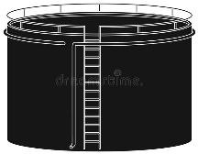
Marine Carbon Capture System
Two main approaches are available to capture Carbon/CO₂ from ships
Shore or offshore based facility
Capture
(pre-combustion from fuel
or
post-combustion from
exhaust gases)
Packaging
Storage
(onboard in dedicated tanks)
Removal
(Carbon/CO₂ offloading/discharging equipment)
(Carbon/CO processing
2
equipment)
Propulsion Engine(s) Exhaust
Gases
Auxiliary Engine(s) Exhaust Gases
Oil-Fired Auxiliary Boiler(s)
Exhaust Gases
Pre- Combustion
Fuel Input
Post-Combustion
Chemical Absorption
(chemical
solvents)
Membrane Separation
(polymer
filtration)
Physical
Separation
(adsorption)
Cryogenic
Separation
(cooling)
Calcium Looping
(mineralization)
Fuel-Reforming
Thermo-Catalytic Decomposition

Slide 6
Post-Combustion Carbon Capture Technologies
Chemical absorption is the most mature and widely applied method for post-combustion carbon capture
Chemical Absorption
(chemical solvents)
Membrane Separation
(polymer filtration)
Physical Separation
(adsorption)
Cryogenic Separation
(cooling)
Calcium Looping (mineralization)
Uses liquid amines to selectively capture CO₂ from exhaust
Compatible with retrofits (no engine modification)
Challenges: energy demand,
space, solvent degradation
Most mature and widely demonstrated OCCS option
CO₂ separated via selective polymer membranes
Compact and modular, no solvents
Lower capture efficiency
Membranes are prone to impurities, moisture and high exhaust gas temperatures
Low–medium TRL for shipping
Uses solid sorbents, to trap
CO₂ from exhaust gases.
Reduced regeneration
energy requirement
Modularity of systems.
Sorbents are prone to degradation and significant number of adsorption column requirement for large scale applications
Very limited application in
the marine industry
CO₂ removed by cooling and condensation
Can deliver high-purity CO₂ product without chemical solvent handling.
Higher electric power requirement and refrigeration complexity
Low-medium TRL in shipping, viability is largely restricted to LNG-powered vessels.
A cyclical process involving carbonation and calcination. CO₂ reacts with quicklime to form Calcium Carbonate (CaCO₃).
High capture potential, simplified operations w/o pressurised or cryogenic CO₂ handling
Requires solids handling and
disposal
Medium- high TRL through successful pilot tests

Slide 7
Operational Suitability of Carbon Capture Technologies in Liner and Tramp Shipping
OCCS Technology | Marine TRL (1–9) | Liner Shipping Suitability | Tramp Shipping Suitability | Key Considerations
Chemical Absorption (Amine-based) | 7–8 | High | Low | Most mature; Successful pilot-scale marine trials. Requires heat and LCO₂ handling
Membrane Separation | 4–5 | Medium | Low | Compact/Modular Energy-intensive; limited marine demonstrations
Physical Adsorption (Solid Sorbents) | 4–5 | Medium | Low | Lower energy potential Requires complex regeneration and limited applications
Cryogenic Separation | 4–5 | Medium | Low | Strong synergy on LNG Carriers High power demand, no marine-scale deployment
Calcium Looping (Solid CaCO₃ Storage) | 6–7 | High | Medium | No offloading infrastructure needed. Industrial maturity is higher, but shipboard integration immature
Thermo-Catalytic Decomposition | 4–5 | Medium | Medium | Lab/pilot maturity only; no marine-ready systems Avoids LCO₂ logistics. Byproduct (solid carbon) is easier to offload
Marine Bicarbonate Method (Ocean Discharge) | 4–5 | Medium | Medium | Avoids CO₂ storage and reduces port dependency Regulatory acceptance remains uncertain

Slide 8







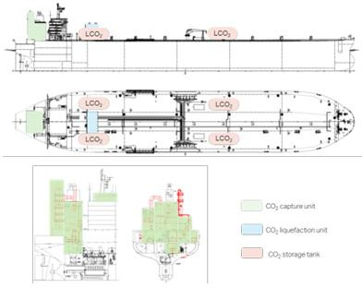
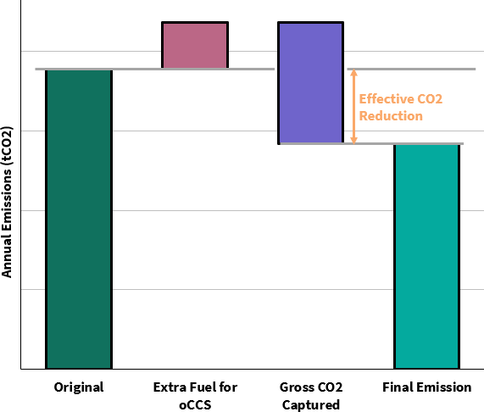
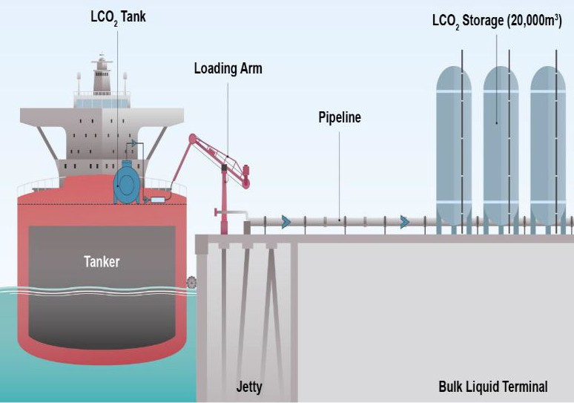
Integration Challenges and Operational Impacts
The installation of CCS systems requires significant onboard space and introduces additional energy needs
Onboard Storage & System Integration
Energy Demand
Port & Infrastructure
Readiness
Limited port capability for capture-grade
CO₂ offloading
Significant space requirement and
Material parasitic load on ship power
systems
additional weight driven by LCO₂ storage
Vessel type matters; bulkers most constrained
~10–25% higher energy demand, impacting fuel use and net capture benefit
Storage and transport networks remain
early-stage and fragmented
Retrofitting is often layout-constrained,
particularly on upper deck availability
PTO and WHR solutions to generate
electricity or cooling
Lack of standardised offloading rules
reinforces near-term integration risks
Source: Global Centre for Maritime Decarbonisation
Source: Mærsk Mc-Kinney Møller Center for Zero Carbon Shipping

Slide 9
Presentation of the Disposal Pathways

Slide 10

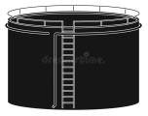
What is CC(U)S?
A suite of technologies that capture carbon dioxide and prevent it from reaching the atmosphere
Capture
(pre-combustion from fuel or post-combustion from exhaust gases)
Packaging
(CO₂ processing equipment)
Storage
(onboard in dedicated tanks)
Removal
(CO₂
offloading/discharging equipment)
Step 4
Step 1
Step 2
Step 3
Utilisation
Shore or offshore based facility
Post Combustion Capture
Non-Conversion use
Geological Storage
Pre Combustion Capture
Conversion
Enhanced Oil Recovery
Oxyfuel Capture (*)
For Synthetic Fuel production
For Industrial and agricultural use
(*) Oxy-fuel combustion technologies are currently at laboratory to pilot scale, with limited commercial deployment. As such, they were not assessed further in
this study.
10

Slide 11
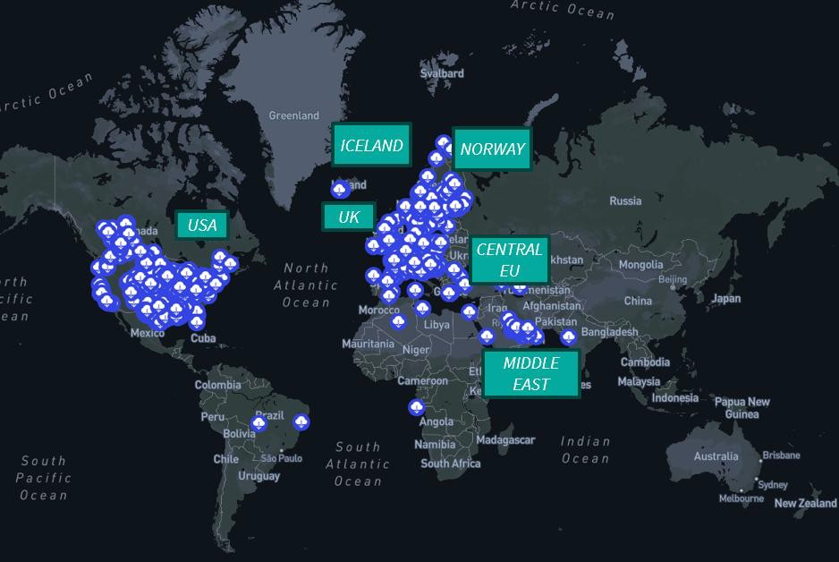

Overview of CCS Projects
CCS deployment is accelerating rapidly but unevenly, with large-scale capacity concentrated in the US and Europe progressing through smaller, infrastructure-led projects.
Americas
Pipeline-led mega-hubs deliver scale and certainty, with limited
reliance on CO₂ shipping.
Europe and UK
Open-access North Sea hubs make CO₂ shipping central to CCS
deployment.
APAC and India
Fragmented emitters drive hub development where CO₂ shipping
closes infrastructure gaps.
Japan is building CCS hubs around exporting captured CO₂ for
overseas storage.
China
CCS scales through domestic, integrated hubs with minimal cross-border transport.
Total number of commercial CCS projects in operation
Middle east and Africa
High-capacity storage hubs position the region as a future CO₂
77
47 in construction
610 in development
734 projects in pipeline, up 17% year in one year
import destination.

Slide 12
Port Interface Requirements
Technical, operational and quality requirements for shore reception
CO2 HANDLING (LIQUID CO₂)
Offloading & Transfer:
Cryogenic liquid CO₂ transfer (ship to shore)
Vapour return for pressure control
Typical rates: 150–500 m³/h
Port Infrastructure Needs:
Buffer storage tanks
Pumps & vapour handling systems
Pipeline integration to storage
Key Constraint:
Must meet injection-ready CO₂ specifications
Carbon Byproducts
Offloading & Transfer:
Standard bulk or containerised handling (no cryogenics)
No vapour return required
Comparable to conventional dry cargo operations
Infrastructure Needs:
Existing bulk terminals or container yards
Cranes, conveyors, and storage areas
No dedicated CCS infrastructure required
Key Constraint:
Market driven specifications

Slide 13
CO₂ Offloading, Transport & Disposal Costs
Cost is driven by infrastructure, utilisation, and risk, not just technology
TRANSPORT
Shipping 45-90 €/tCO2
PIPELINE 5-25 €/tCO2
STORAGE
Depleted gas fields 2-13€/tCO2
Saline aquifers 4-32€/tCO2
Capture
27-108 €/tCO2
Market Tariffs ≠ Technical Cost
Commercial structure shapes pricing
Risk allocation
Long-term liability
Infrastructure financing
Immature storage markets
Key cost drivers
CO₂ quality & pre-conditioning
Pressure–temperature alignment
Scale & utilisation rate
Storage readiness & reservoir type
Regulatory liability

Slide 14
Review of the Regulatory framework

Slide 15



Regulatory Review of Onboard Carbon Capture and Storage (OCCS)
In absence of regulatory clarity, the commercialisation of OCCS is constraint, despite the strong potential of abating
shipping related GHG emissions
IMO Regulatory Framework
The global maritime regulator for matters of safety, pollution and decarbonisation
EU Regulatory Framework
A solid and developed framework, able to provide economic incentives for innovative technologies
Classification Societies
Providers of the practical way forward for the adoption of emerging technologies like oCCS
International Conventions
The applicable international laws, governing the movement of oCCS products and the
creation of a global value-chain

Slide 16
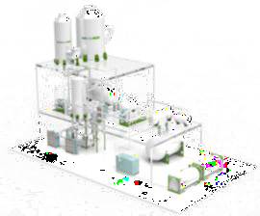
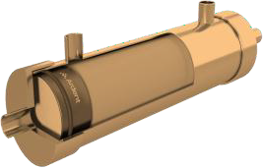
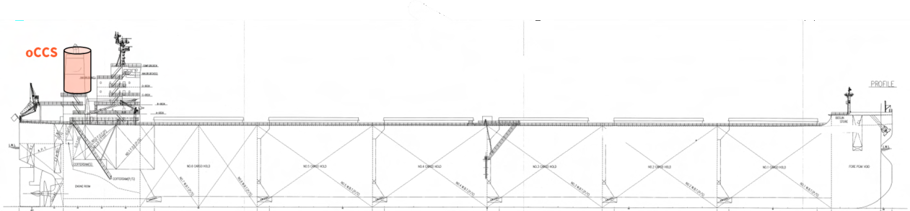

OCCS in the IMO Regulatory Landscape – Short term measures
OCCS is not accounted in IMO Sort-terms measures in absence of technical specifications and reporting procedures
Interaction with EEDI/EEXI
Interaction with CII
Current state: No recognition of capture, storage and offloading of CO₂
Pending item: Inclusion of captured CO₂ to reportable parameters under DCS/CII guidelines.
Current state: No inclusion of post-combustion treatment technologies
Pending item: Methodology accounting the “by design” operation of
CCS installed
Potential way forward: Introduction of OCCS-related correction factor building on previous examples of the framework. Transfer of custody between ships and reception facilities. Formal certification on captured quantities and verification of permanent storage or utilisation
Key insight for adoption: The DCS regulation allows for direct CO₂
measurements
Onboard measurement
(PER VOYAGE)
At reception facility
(PER DELIVERY)
Downstream
VERIFICATION

Slide 17
OCCS in the IMO Regulatory Landscape – IMO NZF and LCA guidelines
OCCS is recognised as a significant pathway towards IMO targets, but methodological development is pending
IMO NZF
IMO NZF
HFO
Base Target MDO
LNG
Direct target
ZNZ Threshold
Years
120
120
100
80
60
40
20
0
2028 2029 2030 2031 2032 2033 2034 2035
Momentum: OCCS to be included in IMO NZF as an emission abatement technology
Plan for inclusion: Potential emission credit for CO₂ captured on board and delivered off the ship
Methodological approach: Crediting to align with LCA methodology e_{OCCS} factor
Pending item: The procedure to determine and verify CO₂ emission credits. The methodological guidance for verification of data related to OCCS systems
100
Base Target
HFO
80
GFI (gCO2eq/MJ)
MDO
GFI (gCO2eq/MJ)
Direct target
60
LNG
With 30% CR
40
ZNZ Threshold
20
0
2028
2029
2030
2031
2032
2033
2034
2035
Years
19

Slide 18
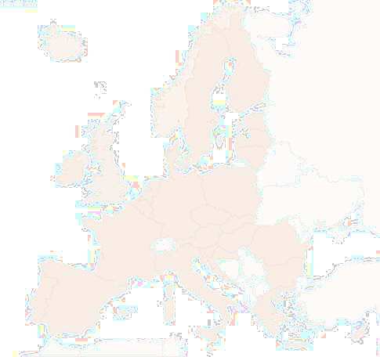

EU Decarbonisation Regulatory Framework
Asymmetry under EU regulation with acceptance under EU ETS but exclusion from FuelEU
EU Emissions Trading System (EU ETS)
Current state: crediting of captured CO₂ is acceptable, provided permanence
Requirements for adoption: Captured CO₂ to be stored according to “CCS Directive” or delivered for permanent utilisation
Key insight for consideration: Governing parameters is “the amount of CO₂ handed over for storage”. Onboard capacity will play a vital role
Practical take: OCCS crediting is acceptable, but no formal application has been confirmed to date
CO₂
FuelEU Maritime
Current state: OCCS not addressed within the existing methodology
Preventing parameters: OCCS theoretically supports the use of fossil fuels. Lack of maturity, demonstrated results and international framework for long term sequestration
Potential way forward: Regulatory opening for future inclusion subject to availability of monitoring mehtodology
Key insight for adoption: OCCS may become an important source for biogenic and synthetic renewable fuels
CO₂
21

Slide 19
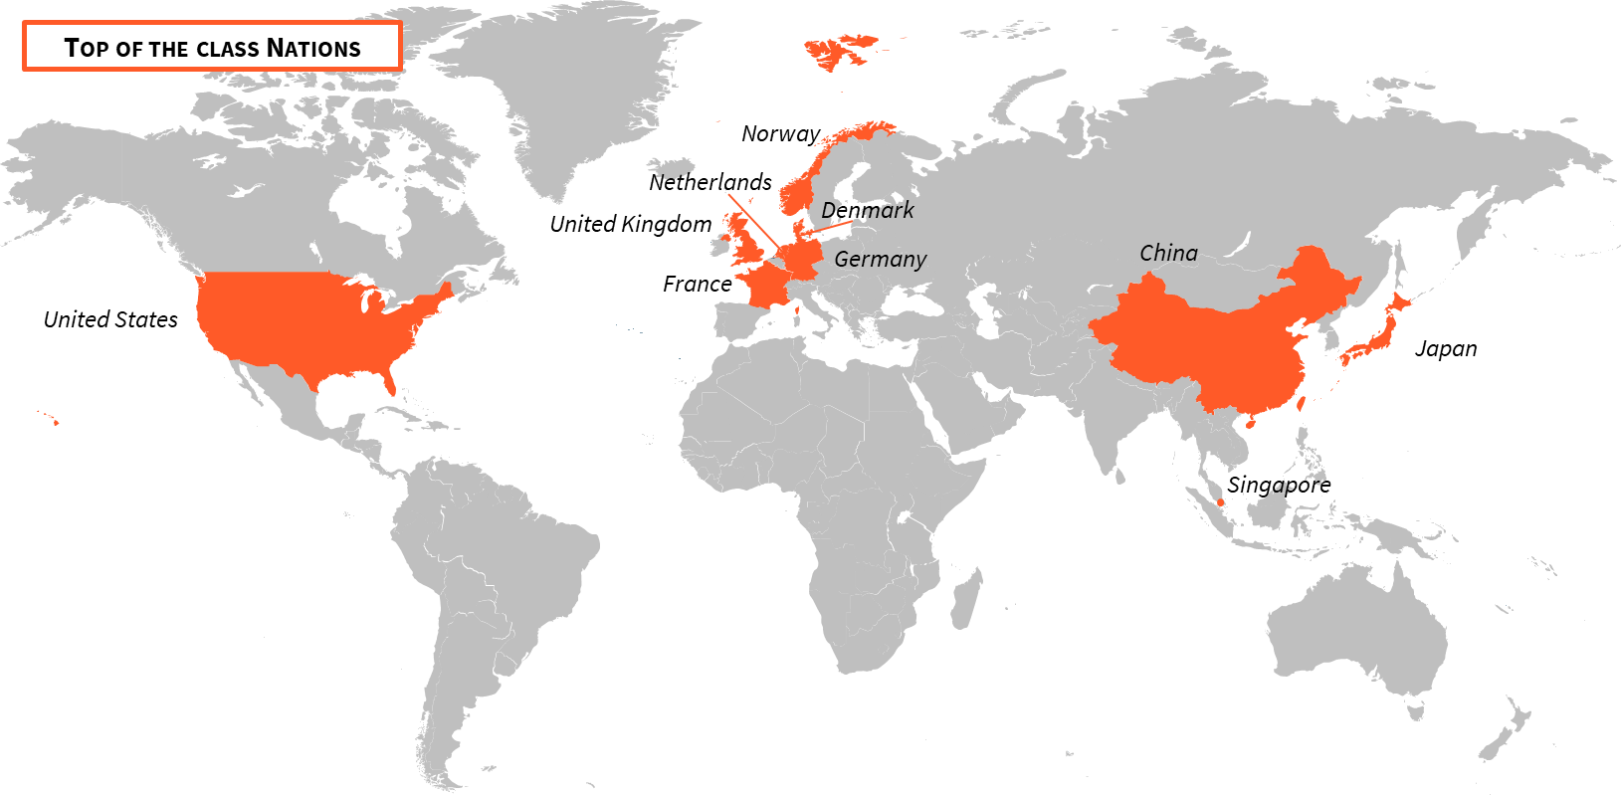


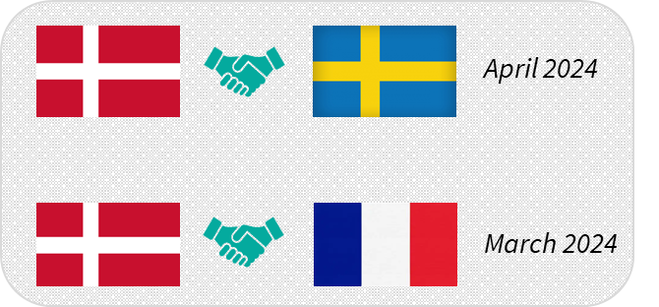
National Initiatives Relevant to OCCS & CO₂ Offloading
N. Europe leads in the creation of a CCS value chain while regional initiatives in Asia and America are scaling
Cross-border multilateral agreement between 5 N. Europe nations
April 2024
Bilateral agreement between EU Nations

Slide 20
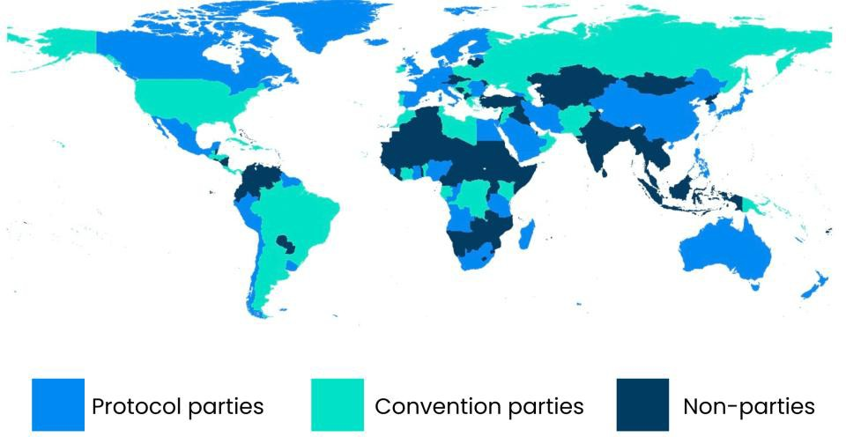
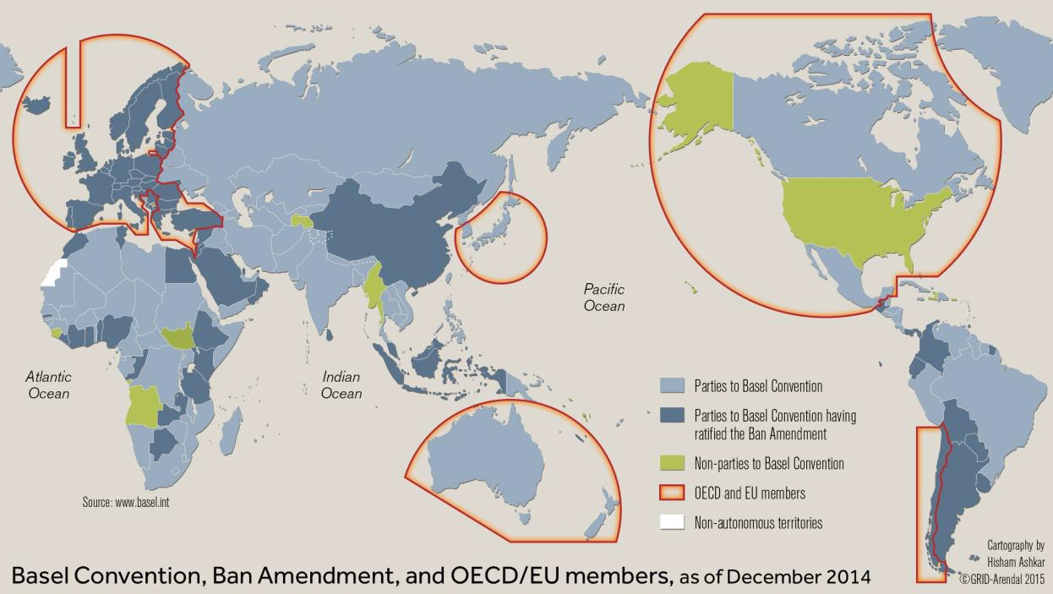
International Conventions Regulating the Movement of CO₂
The Internation Framework is fragmented based on national status and CO₂ categorisation, creating a barrier to cross-
border transportation carbon captured products
London Convention & London Protocol
The Basel Convention
Regulate the dumping of wastes and other matter at sea
The 2006 amendment allow sub-seabed geological storage of CO₂ (prohibits exports)
The 2009 amendment allows export for sub-seabed storage (not enforced)
Regulates the transboundary movement of wastes and their disposal
Requires PIC procedures for transport of waste
The “Ban Amendment” forbids the open transport of hazardous wastes
A 2019 resolution allows provisional application
The categorization of Capture CO₂ becomes vital

Slide 21




The Role of Classification Societies in the Adoption of OCCS
Class societies are enabling early OCCS deployment through risk-based approvals and AiPs, while full prescriptive rules are
still emerging
No harmonized global OCCS code
Use of Approval in Principle (AiP)
Lack of unified design criteria
Risk-based design and early HAZID/HAZOP studies
Incomplete alignment with port reception rules
Application of parts of IGC Code, IGF Code and SOLAS
Limited prescriptive safety requirements
Development of Unified Requirements under IACS

Slide 22
Conclusion & Key Findings

Slide 23




OCCS – Key Integrated Conclusions
OCCS success is driven by alignment, across ships, systems, and storage, not by capture technology alone
Technology Readiness
Amine based post-combustion systems lead near-term deployability.
Alternatives remain
segment-specific and early-stage.
Vessel Integration
Larger, energy-rich vessels are the most viable
early adopters.
Space, power, and heat availability are binding constraints.
Strategic Takeaway
Prioritise pilots on favorable vessels, secure early emitter-receiver links, and engage regulators.
Treat OCCS as a compliance-readiness
investment, not a standalone solution.
CO₂ Value Chain & Port Access
OCCS only works with credible offloading, transport, and storage pathways.
Ports and hubs remain the critical bottleneck.
Regulation & Compliance
OCCS has technical validity, but compliance value today is limited outside EU ETS.
Regulatory recognition and monitoring frameworks are the primary unlock.
Geography & Hubs
North Sea is most mature. APAC hubs can extend OCCS to tramp trades.
Cross-border legal alignment is decisive.
28

Slide 24


Thank you
lr.org/advisory advisory@lr.org
Emil Shivachev
Technical Consultant – LR Advisory
+443304140364
Emil.Shivachev@lr.org
Olympia Tsitonaki
Maritime Decarbonisation Consultant –
LR Advisory
+302119907550
Olympia.Tsitonaki@lr.org
Iason Kontochristos
MPS Technical Specialist – LR Advisory
+302119907702
Iason.Kontochristos@lr.org
Visit: lr.org/advisory

